Slide 2
Save money without impacting eligibility for certain means-tested benefits
WHAT IS ABLE?
The Achieving a Better Life Experience (ABLE) Act of 2014 created savings and investment
accounts for individuals with disabilities
SSI
Medicaid

Slide 3
WHAT IS ABLE?
ABLE accounts have hybrid functionality
529 College Savings
Checking Account
Special Needs Trust
Notes:
No change to content

Slide 4
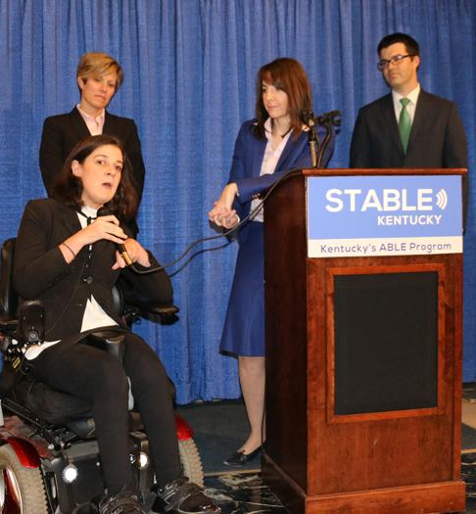
WHAT IS STABLE Kentucky?
Kentucky’s ABLE plan
Administered by the Kentucky Treasurer’s Office
Launched December 13, 2016
Offered to Kentucky residents through the Ohio STABLE Account Program

Slide 5
BENEFITS OF STABLE ACCOUNTS
FINANCIAL INDEPENDENCE
OWNERSHIP
TAX BENEFITS
Account is owned by the individual living
with the disability
Eliminate spend-down and increase the amount of short-term and / or
long-term savings
May qualify for multiple tax benefits
each year

Slide 6
ELIGIBILITY
To see who qualifies for STABLE Account,
take our eligibility quiz at stablekentucky.com
An individual living with a disability
that occurred prior to age 26
PLUS ONE OF THE FOLLOWING:
Eligible to receive SSI or SSDI due to disability; or
Condition listed on SSA’s “List of Compassionate Allowances Conditions”; or
Self-certification

Slide 7
WHAT IS
SELF-CERTIFICATION?
Need diagnosis of a physical or mental impairment that causes “marked and severe functional limitations”
Condition has lasted or is expected to last for at least 1 year
Do not need to send in written diagnosis, but must have on hand

Slide 8
ENROLLMENT
Free online enrollment at stablekentucky.com
Quick & easy process
$25 minimum opening deposit

Slide 9
ENROLLMENT Can be completed by:
Authorized Legal Representative (ALR)
Agent under a Power of Attorney
Conservator / Legal Guardian
Spouse
Parent
Sibling
Grandparent
Social Security Representative Payee
… in that order, and that there is no other willing and able person with a higher priority as listed above to establish the ABLE account.
Individual
with a disability (Accountholder)
OR

Slide 10
FUNDING YOUR ACCOUNT
EFT
(Electronic Funds Transfer)
Check
Payroll
Direct Deposit
Notes:
No change to content

Slide 11
Payroll Direct Deposit For Employees
with Disabilities and Their Families
INCLUSION
Benefits for Your Company
Adds a no-cost benefit for your company and employees
Provides every employee the opportunity to save and invest in their future
Promotes inclusion and brings financial parity to your workforce
EMPOWERMENT
Benefits for Your Employees
Employees living with disabilities can now save more money while keeping public benefits
Easily set up payroll deduction for themselves or family members living with disabilities
Diverse savings and investment opportunities through STABLE Account

Slide 12
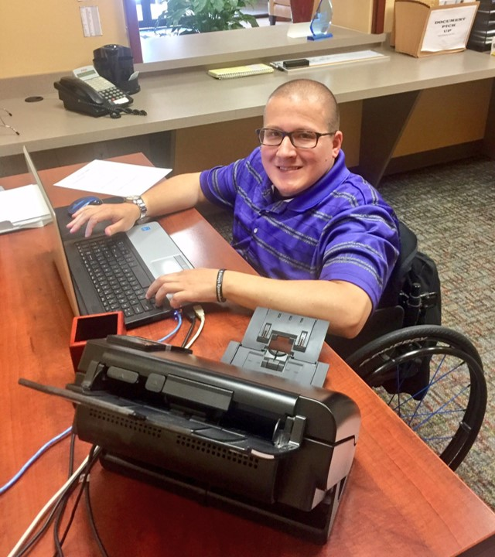
FUNDING YOUR ACCOUNT
IF NOT EMPLOYED
IF EMPLOYED
$18,000 per year from all sources
Up to $32,580 per year
LIFETIME LIMIT
$541,000 balance limit
System automatically rejects excess contributions

Slide 13
FUNDING YOUR ACCOUNT
IF NOT EMPLOYED
$18,000 per year from all sources
System automatically rejects excess contributions

Slide 14
FUNDING YOUR ACCOUNT
IF EMPLOYED
Up to $32,580 per year
$18,000 + wages up to an additional $14,580
System automatically rejects excess contributions

Slide 15
FUNDING YOUR ACCOUNT
LIFETIME LIMIT
$541,000 balance limit
System automatically rejects excess contributions

Slide 16
The Gifting Page allows anyone to give financial gifts...directly into the STABLE Account
Contribute to Amy’s Future
Amy’s Gifting Progress
Looking for the perfect gift? A gift contribution to an ABLE account can help pay for everyday expenses and care down the road. Plus, it’s easier than wrapping a present. Thank you for contributing to Amy’s future.
Does NOT count as a RESOURCE or INCOME

Slide 17
Choose From
INVESTMENT
OPTIONS
Four Vanguard mutual funds ranging from aggressive to conservative
One principal-protected FDIC-Insured option

Slide 18
ACCOUNT COST
There is a minimal cost for owning a STABLE Account
Monthly Maintenance Fees
Asset-Based Fees
Kentucky Residents
$2.25 per month
($6.75 charged quarterly)
Kentucky Residents
Between 0.19% and 0.33%

Slide 19
SPENDING
YOUR FUNDS
Withdrawals must be used on
“Qualified Disability Expenses”
Must relate to the disability + help maintain or improve health, independence, or quality of life
Housing & Rent
Basic Living Expenses
Transportation
Education
Assistive Technology
Financial Management
Health & Wellness
Legal Fees

Slide 20
SPENDING FROM YOUR ACCOUNT
CHECKING & SAVINGS
Transfer to personal
checking or savings
THIRD-PARTY
Pay with a
Third-Party Check
THE STABLE VISA CARD
Transfer onto
STABLE Visa Card

Slide 21
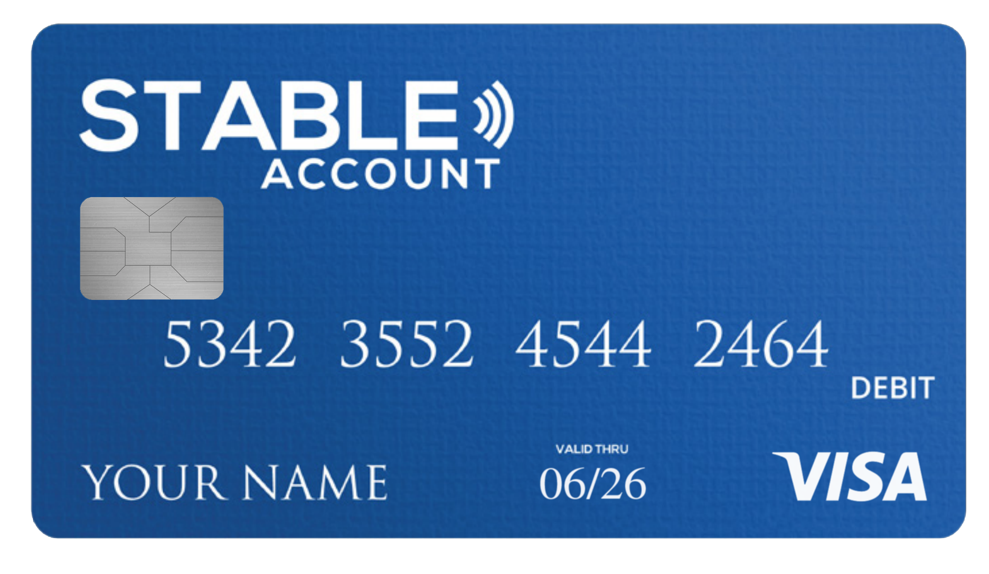
STABLE VISA CARD
The STABLE Visa Card is a loadable/prepaid card that can be used anywhere Visa is accepted
LOADABLE
PROTECTIONS
Provides controlled access to spending
No overdraft, no cash access, able to limit merchants and types of expenses
TRACKS EXPENSES
ALERTS
Online spending records with ability to add notes
Notifications to monitor spending and low balances

Slide 22
SSI CONSIDERATIONS
Supplemental Security Income
Balances over $100,000 count as a resource – but SSI merely suspended, not terminated
If you hold on to the money from one calendar month to the next, then housing expenditures count as resources
Accountholder’s own wages still count as income even if contributed to a STABLE Account

Slide 23
IF ACCOUNTHOLDER
PASSES AWAY
Account will pass to the accountholder’s estate
The estate administrator notifies STABLE Account Customer Service and can take over account access
If the accountholder does not have a will then the account will go through normal probate process

Slide 24
MEDICAID Payback
SB 160 Passed and Signed into Law on 3/31/2023 for STABLE Kentucky Accounts
SB 160 States
Federal Law
STABLE accounts are not subject to claim by the Cabinet for Health and Family Services unless required by Federal law
Be, on the death of the designated beneficiary, transferred to the estate of the designated beneficiary, unless prohibited by Federal law
Currently section 1917(b) of the Federal Social Security act, 42 U.S.C. §1396p(b), requires states to recover assets when the account owner was over 55 years of age and used Medicaid for nursing home or in-home nursing care benefits.

Slide 25
STABLE ACCOUNT &
SPECIAL NEEDS TRUSTS
Complementary tools that can be used together
Unique STABLE Account benefits
Broader spending power (i.e. housing and food)
No federal or state income tax on earnings
Can be established, administered and owned by an individual with a disability
Trusts can make distributions to STABLE Accounts
Trusts can accept unlimited cash and non-cash assets
Trusts can accept funds or non-cash assets for a person whose disability occurred after age 26

Slide 26
WE’RE HERE TO HELP!
CUSTOMER SERVICE INFORMATION
1-800-439-1653
Monday - Friday (9 am - 8 pm EST)
team@stableaccount.com
stablekentucky.com
Notes:
No content change

Slide 27
SPREAD THE MESSAGE
Find us on Facebook
@TreasurerBall
Find us on Twitter
@KYTreasurer

