Slide 1
Set Up Your Training For Success
Using Titles, Descriptions and Other ECE-TRIS Fields to
Notes:
Welcome to this Beyond Fundamentals training: Using Titles, Descriptions and Other ECE-TRIS Fields to Set Up Your Training for Success. We are so excited you are joining us for this independent study course. In this short welcome section, we will give you some more information about the flow of the course.

Slide 2
Course Outcomes
Workplace Outcome
Training Outcomes
Trainers will write effective titles and descriptions and use ECE-TRIS to set up their trainings to reach appropriate users and to ensure trainings can be considered for incentive programs such as badging and All STARS.
Explain the importance and benefits of using ECE-TRIS fields to set up trainings accurately.
Develop meaningful titles and comprehensive training descriptions.
Select appropriate core content subject areas, training type and other set-up fields based on training topic and audience.
Notes:
First, please take a minute to read the workplace and training outcomes. Our hope is to support you in using ECE-TRIS to set up your trainings for maximum impact. Next, we will discuss the course materials and flow.

Slide 3
Course Materials and Roadmap
Materials on HDI Learning Welcome page
READ ME First Course Roadmap
Slides, notes with multiple ways to access
Tip sheets
Fill-in Journal and application assignment
All course assignments are due by midnight EST, 3/18/24.
Notes:
In this independent study course, you can work at your own pace and have different ways to access the materials. Your Regional Training Coach is available as a resource throughout the training, and you will email your final assignment to them. There will also be alternate ways to complete the assignments if needed. On the welcome course page in HDI Learning, you were able to access and print materials. You can download many materials to view offline. We also want to support you in accessing the material in a way that fits your learning style. The READ ME First Course Roadmap will guide you in the steps to complete the course and includes links to watch course videos. You will want to keep the roadmap handy as it will serve as your course “syllabus”. There is also a PowerPoint presentation with options on how to access it. You can read the slides and notes, watch the presentation on video, or download a pdf for offline reading. There is a tip sheet you will download, and a Fill-in Journal with application activity that can be printed out or completed online. At the end of the course, you will email your completed Fill-in Journal and application activity to your coach for grading. There will be different reflection points and practice activities in your journal throughout the training, so make sure you complete those too.

Slide 4


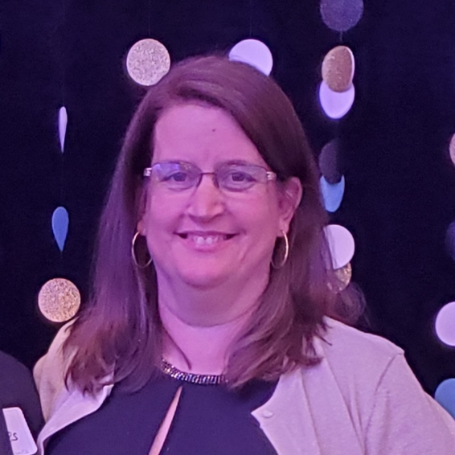
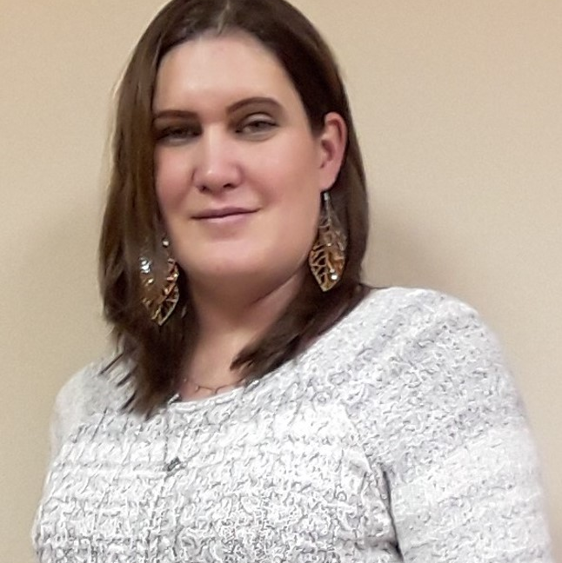

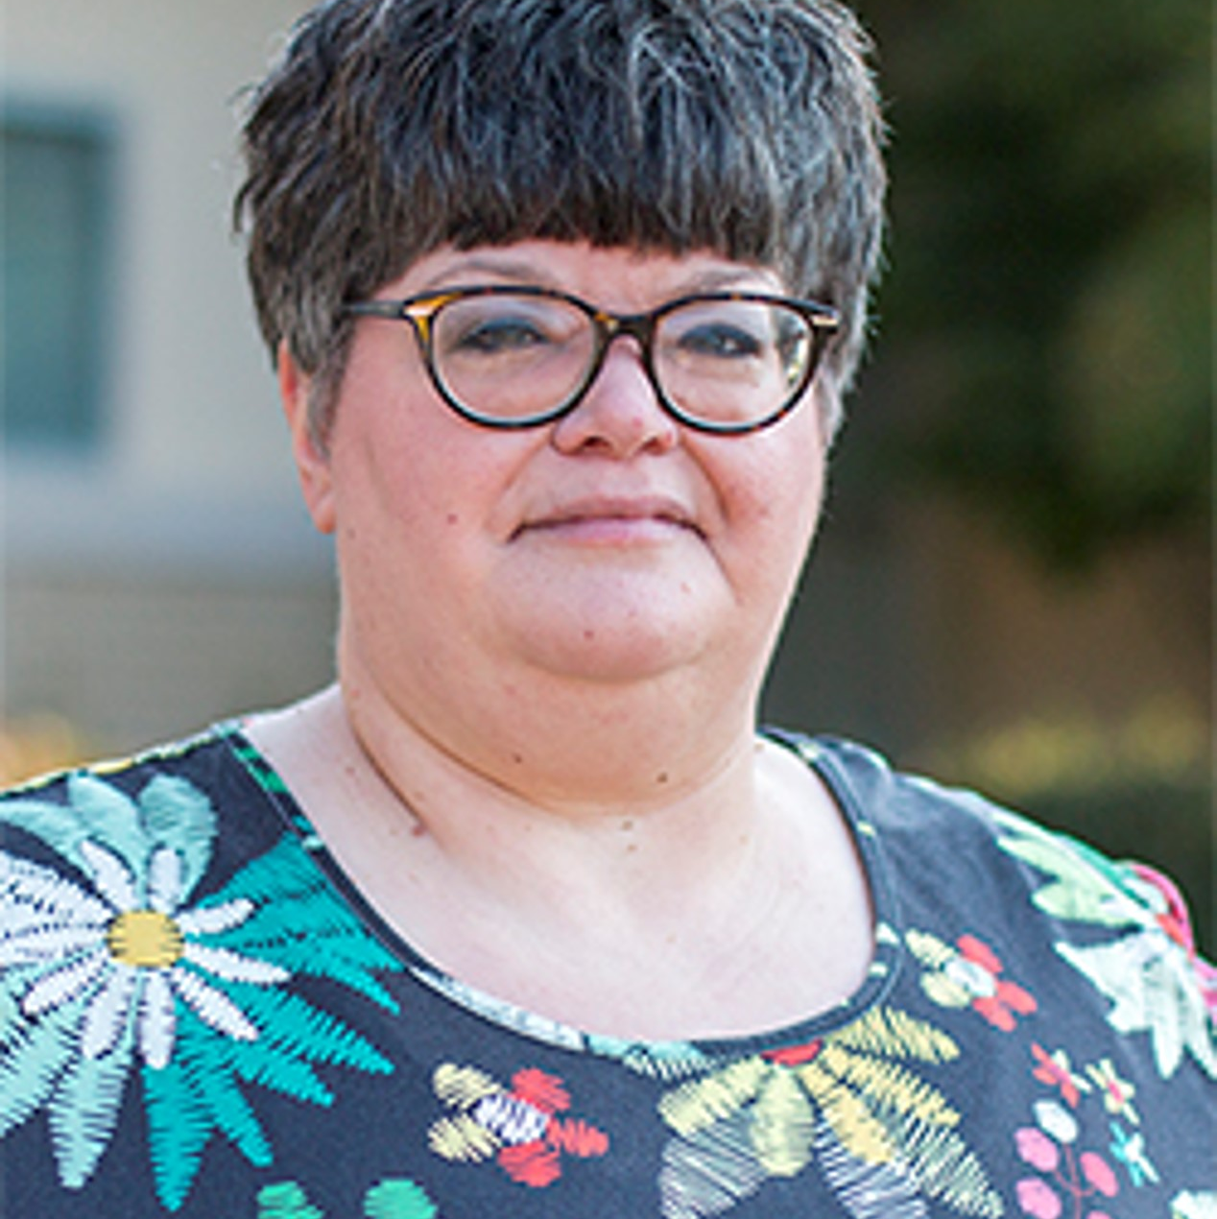
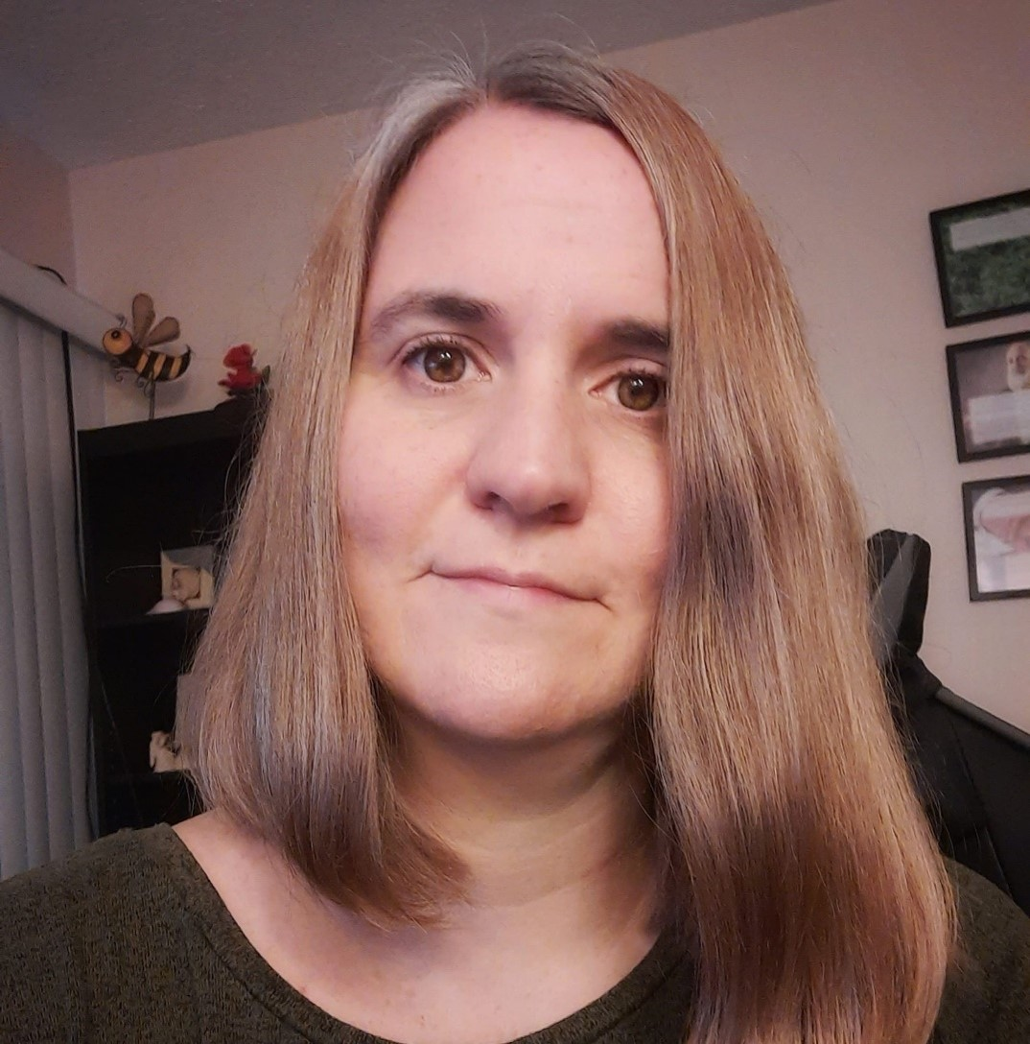


Training Coach Team
April Brown
Bambi Cliffe
Bethany Hughes
Candace Storrer
The Lakes
Southern Bluegrass
Two Rivers
Salt River Trail
Glenna Gamble
Julie Halitzka
Sharon Norris
Christine Hausman
Cumberland
Eastern Mountain
Jefferson
Northern Bluegrass
Content Coordinator
Notes:
Your Regional Training Coach will be your guide throughout this training! If you are not sure who your coach is, you can check at the link in your READ ME First Course Roadmap ( https://www.childcareawareky.org/about-child-care-aware/coaches/. )

Slide 5
Let’s Get Started!
1. Review the training set-up page on ECE-TRIS. Note any questions you have in your fill-in journal.
2. Contact your Regional Training Coach to set course goals and let them know what questions you have.
3. Complete the Activate Prior Knowledge Activity in your READ ME First Roadmap.
Notes:
Now, let’s get started! Here are your next steps. First, log into ECE-TRIS and review the training set-up page (either for face-to-face or non-face-to-face training). Note any questions you have in your fill-in journal. Remember you can either type directly into your fill-in journal or you can print it out and write in it. Then, you will contact your Regional Training Coach in a way that works for you, to let them know what you are hoping to gain from this course, and any questions you have. Finally, you will complete a short Activate Prior Knowledge activity in your READ ME First roadmap document to get you started thinking about what you know about titles and descriptions.

Slide 6
Importance of Setting Up Your Training Correctly
In ECE-TRIS
Notes:
In this section, we will discuss why it is important to set up your trainings correctly in ECE-TRIS. We know you are VERY busy and have spent a lot of time planning interactive and meaningful trainings. So why is the right set-up information on ECE-TRIS important?

Slide 7

Why does it matter?
Notes:
It benefits you as a trainer to set up your trainings accurately! Using ECE-TRIS fields appropriately will help you market your trainings by making sure your target audience can find your content when they are searching on the ECE-TRIS calendar. If the title, description, training type and other fields don’t fully communicate the purpose and benefits of your training, it is less likely potential trainees will sign up. Another important reason to set up your trainings carefully on ECE-TRIS is that this information is used by the Division of Childcare when considering whether a training qualifies for extra programs such as the infant-toddler or school age badging or credentials, or to meet All STARS training standards. We will discuss these programs further in the course. Remember that whether or not you put your trainings on the ECE-TRIS calendar, if your information on ECE-TRIS is incomplete, you may miss out on opportunities to support your learners in having your trainings meet the requirements to count for these extra incentives.

Slide 8
Fill-in Journal Activity
In one sentence, summarize why it is important to you to set up your trainings correctly in ECE-TRIS.
Notes:
Now it’s time for a Fill-in Journal reflection activity. As you learned in the welcome section, we will have different short activities throughout this course to help you reflect on and practice the content. Remember that these activities will be reviewed by your Training Coach along with the application activity at the end of the training. You can also reach out to your coach with questions at any time! For this activity, take a minute to summarize in one sentence in your fill-in journal why it is important to you to set up your trainings correctly in ECE-TRIS.

Slide 9
Start with a Meaningful Title
Notes:
When setting up your training, the first thing to think about is developing a meaningful and intentional title! Your title gives your learners a little bit of information about the program, and it is often the way prospective learners search for trainings on ECE-TRIS. What does being intentional mean? We should be giving a little insight to the training with the title and more information with the description (which we will discuss in the next section). We should be mindful of potential participants’ needs when we create titles. Think about a training titled “Time is Up”. How discouraging for you if you thought the training was about helping children transition, and you learned instead that it was about meeting deadlines for CCAP!

Slide 10

What do you look for in a title?
Notes:
What do you look for in a title when considering a training? Often what we see in that title makes us want to look farther into the training or we just forget it and move on to the next one.

Slide 11



Training Title
Fun, Fun, Fun.
What do you think this training would be about?
Notes:
We have all seen those trainings that are titled very vaguely. If you are looking at this title, Fun, Fun, Fun (and we all love to have fun), wouldn’t it be a big disappointment for you to pay for the training and get there to find out the trainer actually used sarcasm in the title, and the training is about rules and regulations?

Slide 12

Intentional Titles
The words you choose for your title may be the only thing a potential trainee sees.
Your title should be clear and specific.
Your title should reflect your workplace outcomes.
Notes:
Remember that the title of your training is the first thing that your potential learners will see! When learners search on the ECE-TRIS calendar, they will receive a list of training titles and then can click on titles that interest them to see the description and learn more. Your title should be clear and specific and should reflect the workplace outcomes from your training. For example, if your workplace outcome is to use age-appropriate art materials with toddlers, your title should reflect that. If the training is targeted towards specific age groups or audiences such as preschool or family child-care, it is also helpful to include that information in the title. Even if your training isn’t listed on the calendar, your title may be used in reviews for programs such as All STARS, badging and credentials.

Slide 13
Features of a Title
Inviting
The title should make someone want to enroll.
Interesting
The title should make someone want to know more about what is in the training.
Different
The title shouldn’t be the same old training title.
Notes:
Many of us have been in early care and education for at least several years. It may be hard to find a training you haven’t had, and perhaps even harder to find a training that you get excited about. Think about the last time that you heard about a training that was so appealing, you just HAD to take it. Not necessarily even for hours, but just because you were interested in it! Keep that experience in mind as you are thinking about your titles. You want a title that is inviting and sparks some interest in your potential learners.

Slide 14
Which Title is More Informative?
Title 1
Title 2
Developmental screening using the Brigance Infant and Toddler Screening Tool
Screening and Milestones
Notes:
Let’s practice! Take a look at these two titles. Which do you think is more informative? Why? Both titles share some information but Title 1, Developmental Screening using the Brigance Infant and Toddler Screening Tool more clearly communicates the workplace outcome, key content and the target audience.

Slide 15
Which Title is More Informative?
Title 1
Title 2
Curriculum and Planning
Bringing Curriculum to Life with Lesson Planning Using the Kentucky Early Childhood Standards
Notes:
Now, take a look at the two titles on this slide. Which one is more informative? Which one would be more likely to spark your interest in taking the course? Both titles share some information that the training will include curriculum and planning. Title 2, Bringing Curriculum to Life with Lesson Planning Using the Kentucky Early Childhood Standards communicates the workplace outcome and benefits of the training. It also gives you information that a key workplace outcome is using the early childhood standards to plan. This information could capture your interest if that outcome was important to you.

Slide 16
Fill-in Journal Activity
Using the workplace outcome provided in your Fill-in Journal, write a meaningful training title.
Notes:
Now it’s time for a Fill-in Journal practice activity. Using the workplace outcome and information provided in your Fill-in Journal, write a meaningful training title. To self check, think about: Does the title communicate the workplace outcome? Is it clear, interesting, and inviting?

Slide 17
Write an Accurate Training Description
Slides x - y
Notes:
Now that you’ve practiced with titles, we will review writing accurate training descriptions.

Slide 18

How would you describe your training?
You need to include the major points of your topic and who the training is for.
Your description should include references to the content of your training.
Your description needs to let people know what you expect the participants to learn from your training and do when they return to their workplace.
Do you need to include every detail?
Notes:
How would you describe your training and what should you include in the description? The description doesn’t need to include every detail of the training, but it also shouldn’t just be one sentence. Your description should be an overview of the major points of your training, and who the training is for. You should include some information about the content of your training, though you don’t need to go through every detail. And finally, it’s important to remember that your description should let people know your training outcomes, or what they will learn from the training, as well as the workplace outcome, or what they will do when they return to the workplace. In other words, what are the most important points to you that you want potential participants to learn? How will the training benefit their work?

Slide 19
Which Is Better?
Description 1
Description 2
During this training, participants will learn how to choose age-appropriate materials to place in the different centers for the preschool classroom. Participants will watch videos, brainstorm and be asked to choose appropriate materials for their preschool classroom.
The training will teach choosing age-appropriate materials.
Notes:
Take a minute to read the two training descriptions on these slides. Which do you think is better? (Pause to read.)
If you picked description #1, you are correct. It lets potential learners know what age group is supported by the training, some training content and what the learners will do in their classroom after the training. Description 2, The training will teach choosing age-appropriate materials, doesn’t really offer enough information to potential learners for them to know whether the training would meet their needs. And, description #2 doesn’t give enough information for reviewers such as the Division of Child Care, when considering whether the training demonstrates an All STARS standard or meets badging requirements. We’ll discuss these programs in more detail later.

Slide 20
Which Is Better?
Description 1
Description 2
Participants will learn about lesson plans.
Participants will have several lesson plan templates to choose to use, along with a brainstorm session to share ideas for activities to use for various topics, etc. Participants will take away the knowledge of how and most importantly why to make lesson plans for their classroom. Participants will be given a topic and asked to create a lesson plan.
Notes:
Now, let’s take a look at another practice opportunity. Take a minute and read the two descriptions. Which description do you think is better, and why? If you selected Description 2, you are correct! Description 2 gives more information about training content, learning goals and what participants will be able to do when they return to their workplace.
Would you like to learn more about writing effective training descriptions? Your READ ME First Course Roadmap document includes a link to an optional resource article. You can also access it here: https://www.cypherlearning.com/blog/entrepreneurs/how-to-write-the-best-description-for-your-online-course -

Slide 21
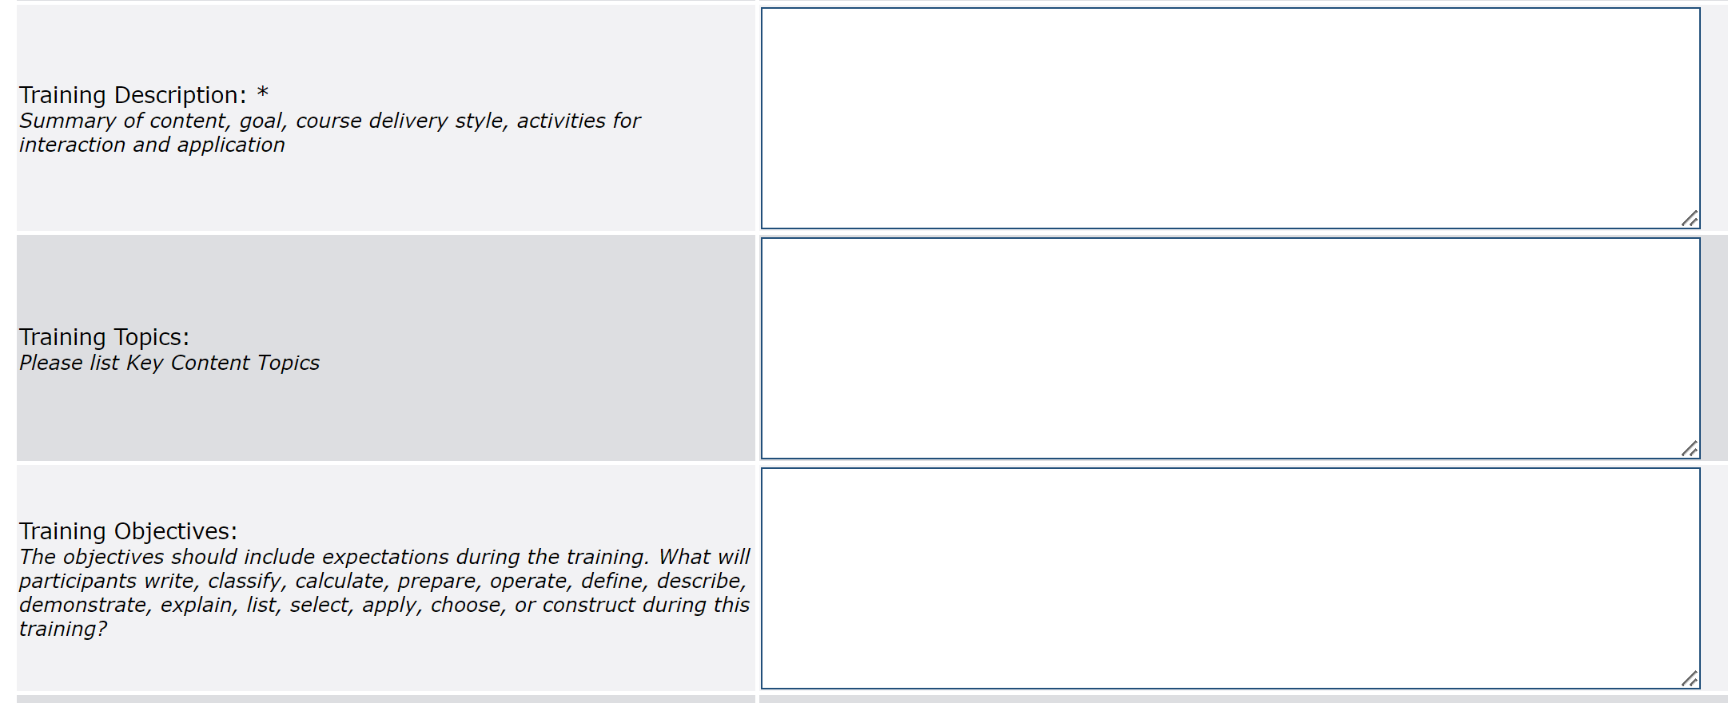

ECE-TRIS Description Entry
And remember - avoid acronyms!
Notes:
ECE-TRIS and the Division of Child Care have observed many issues with incomplete training descriptions entered during training set-up. To encourage greater accuracy, ECE-TRIS has added fields with additional information such as training topics and training objectives, as shown on this slide. Remember that a complete description will include some information about the content, topics, and learning and workplace outcomes of your training. The description field is printed on the training records and is what your learners will use to show the content of their training. It is also an important field used by the Division of Child Care when reviewing trainings for incentives such as All STARS and badging. You can use the training topics and training objectives fields as shown above to provide more detailed information, such as your complete training outcomes or you can copy and paste relevant information from your initial description. ECE-TRIS audits trainings being set-up and attempts to combine the information from the fields on this slide into a more accurate description if necessary. However, this is time-consuming on their part. Additionally, the ECE-TRIS audit for face-to-face set-up will not occur until after a training is completed. We can’t stress enough the importance of entering a complete description in the description field at training set-up, and we will discuss this further in the incentives section. Your Training Coach can also provide technical assistance in this area! And here’s another important reminder – remember that ECE-TRIS wants you to write out complete terms rather than using acronyms.

Slide 22
Fill-in Journal Activity
Answer the questions:
What are the key things that should be included in a training description?
What improvements would you like to make in your training descriptions?
Notes:
Now it’s time for a Fill-in Journal reflection activity. Think about the information you’ve learned about writing an accurate description. In your Fill-in Journal, answer the questions 1. What are the key things that should be included in a training description; and 2. What improvements would you like to make in your training descriptions?

Slide 23
Use Updated ECE-TRIS fields
Review Tipsheet in READ ME First Course Roadmap
Notes:
In this section, you will learn more about using ECE-TRIS fields such as the expanded Training Types, Target Audience, Learning Environment and All STARS checkbox. Please review the Updated ECE-TRIS fields tipsheet in your READ ME First Course Roadmap.

Slide 24
Fill-in Journal Activity
Write in your fill-in journal:
Based on the updated training type definitions, which training types could you train on?
Note any questions you have on training type, target audience, learning environment or All STARS checkbox.
Notes:
Take a minute to review the updated training types from your tip sheet. In your journal, list which training types you could train on. Also note any questions you have. Your Training Coach can help!

Slide 25
Select the Accurate Core Content Subject Area (CCSA)
Using the Kentucky Professional Development Framework
Notes:
One very important field in your training set-up is the Kentucky Core Content Subject Area (CCSA).

Slide 26
Seven Core Content Subject Areas
Child Growth and Development
Health, Safety and Nutrition
Professional Development/Professionalism
Learning Environments and Curriculum
Child Assessment
Family and Community Partnerships
Program Management and Evaluation
Notes:
These seven Kentucky Core Content Subject Areas, or CCSA’s, are found in the Kentucky Professional Development Framework. Choosing an accurate CCSA will help learners find you when searching for the calendar and will also help ensure your training qualifies for applicable incentives such as badging or All STARS. Please watch the video found in your READ ME First Course Roadmap document on using the Professional Development Framework to identify the appropriate CCSA’s for your trainings. You can also click on the link here: https://vimeo.com/907611991.

Slide 27

Print or Download the Kentucky Professional Development Framework
https://kyecac.ky.gov/families/Documents/pd-framework-2011.pdf
Notes:
If you don’t have a copy handy, print or download the Kentucky Professional Development Framework from: https://kyecac.ky.gov/families/Documents/pd-framework-2011.pdf

Slide 28
Fill-in Journal Activity – Let’s Practice!
In your fill-in journal:
Read the three workplace outcomes given.
For each workplace outcome, select the appropriate Core Content Subject Area (CCSA).
Notes:
Now, let’s practice selecting accurate core content subject areas. Remember to use your Kentucky professional development framework as a resource. In your fill-in journal, there are 3 workplace outcomes provided. For each workplace outcome, select the appropriate core content subject area, or CCSA.

Slide 29
Know Set-up Requirements for Extra Incentives
Tips for Success
Notes:
It’s important for you to know the ECE-TRIS set-up requirements if you want your trainings to be considered for extra incentives beyond just licensing hours. In this section, we’ll discuss set-up tips for some important incentive programs.

Slide 30

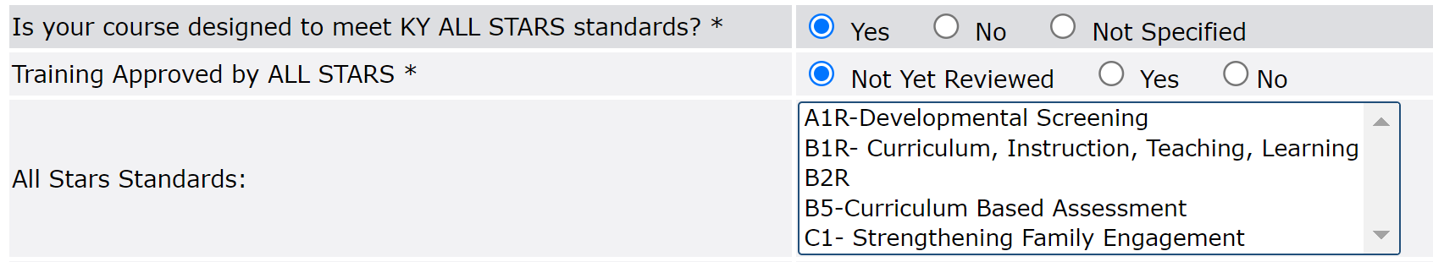
Requirements for
Kentucky All STARS
Know the All STARS training standards
Clear title
Description that shows the intent of the standard is met
All STARS review checkbox and appropriate standard checked on set-up page (when operational):
Notes:
Here are some tips to ensure your appropriate trainings will be considered for Kentucky All STARS. First, take some time to review the four All STARS training standards to make sure you understand the intent of the standard. Your Resource document includes a tip sheet, and your Training Coach can also serve as a resource: https://www.childcareawareky.org/wp-content/uploads/2023/06/Kentucky-All-STARS-Training-Standards.pdf. Next, make sure your description is comprehensive and clearly communicates how your training meets the intent of the All STARS standard you are trying to demonstrate. Finally, as you are entering your training on ECE-TRIS, you can select the checkbox “yes” that your course is designed to meet Kentucky All STARS standards, and then select the standard from the drop down box your training meets. Once the All STARS fields are fully operational (expected soon), that will trigger a Division of Child Care review for All STARS approval. Prospective learners will also be able to search on ECE-TRIS for All-STARS approved trainings. In the short term, your Training Coach can also submit your training for an All STARS approval review if you email course information to them.

Slide 31
Requirements for
Infant and Toddler and School-Age Digital Badging
Choose appropriate age group as training type
Title indicating age and content
Select accurate Core Content Subject Area
Clear description aligning with age group and Core Content Subject Area
Notes:
Digital badging is a new pathway allowing early care and education professionals to focus on a specific topic of professional learning and recognition of the knowledge and skills in the form of a digital badge and bonus incentive. The Kentucky Division of Child Care badges will be 30 hours of completed professional learning that is approved infant and toddler or school-age content. A digital badge will include 30 hours of age-group specific training (either infant and toddler or school-age) with at least 4 hours of learning in each core content subject area (or CCSA). Here are some tips to make sure your applicable trainings can be considered to count for badging. First, the infant and toddler or school-age training type MUST be specified for a training to be considered for badging. Training content must be specific to one badge-related area – either infant and toddler or school-age. You will receive an error message if you try to select more than one training type relating to age group (such as infant and toddler and preschool). However, you can select an age-group related training type with some other training types if applicable. For example, a training type could be infant and toddler and CCCC/CDA. Once you have selected the appropriate training type, make sure that your title indicates the content and preferably the age-group served. In addition, the description should be clearly and professionally written, and include details of the content, what knowledge or skills will be taught, how the training can be applied to a learner’s classroom, and how the new information will impact the field of early care and education. The description should also align with the core content subject area you have chosen. Trainings entered in ECE-TRIS will be reviewed to determine if they meet the guidelines to count for the Infant and Toddler or School-Age badge. If you do not meet the set-up requirements outlined above, your training will not count.

Slide 32
Requirements for
Infant and Toddler and School Age Credentials
Choose appropriate age group as training type
Title indicating age and content
Clear description showing that the training content is appropriate for the age group and CCSA
Notes:
In addition to digital badging, the Division of Child Care has recently introduced the infant and toddler and school age credential regulations. These optional credentials are age-group specific and include three levels. Each level has training requirements, though specific core content subject areas are not required as in badging. For trainings to be considered for credentials, the training type must include the specific age group, either infant/toddler or school age. The description you enter must also show that the content is appropriate for the age group and core content subject area chosen. If the information you enter at set-up doesn’t clearly communicate this information, then learners may not be able to use your trainings to meet credential requirements. Remember, if you have questions about these programs and/or any aspect of training set-up, your Training Coach is here to help!

Slide 33
Application Activity
Key training information
Notes:
Now you can go to your READ ME First Course Roadmap to choose one of three application activity options. The intent is for you to practice writing a meaningful title, comprehensive description and using accurate ECE-TRIS fields to set up a training. Our hope is that this activity will result in set-up information you can use when entering your training in ECE-TRIS. This application activity should take you about 25 minutes.

Slide 34

Next Steps
Email completed Fill-in Journal with application activity to your Coach.
Prefer an alternate way to complete the activity? Your Training Coach can help!
Complete the course evaluation in HDI Learning.
Complete the 2-question reflection quiz within HDI Learning.
Once the application activity, journal and reflection quiz are graded, credit will be assigned.
Notes:
Once you’ve finished your application activity, here are the next steps to finish the course! First, email your completed Fill-in Journal with application activity to your Training Coach. Do you prefer to submit the assignment via audio or video instead? Talk with your Training Coach for options! Once you have sent your Fill-in Journal with application activity to your coach, return to the course in HDI Learning, complete the course evaluation, and answer the 2-question final reflection quiz. Your coach will send you feedback on the application activity and will enter a grade on HDI Learning. Once the Fill-in Journal, application activity and final reflection quiz have been completed satisfactorily and the grade has been entered, course credit will be assigned within 10 days. You can also log into HDI Learning to download a certificate if needed.

Slide 35

Questions? Contact your Training Coach!
Notes:
Remember, your coach is available to answer your questions and assist you with developing high-quality training plans. We are here to help!

Slide 36

Thank you for going on this independent study journey with us!!
Notes:
Thank you for joining us on this independent study journey!

